Slide 1

DRISTI: Disaster Responsive Intelligent Simulation & Tracking Interface
An AI-powered solution for proactive disaster management in large-scale events.
Team Introduction
Project: DRISTI (Disaster Responsive Intelligent Simulation & Tracking Interface)
Theme: Disaster & Emergency Preparedness
Registration Number: TH1353
Team Members
Kanav Jeet Singh
Rachit Garg
Avighna Bhadoriya

Slide 2
THE CHALLENGE
Problem Statement
In dynamic, large-scale public gatherings like the Simhastha Kumbh Mela, a single incident can rapidly spiral into a crisis. Traditional, static emergency response systems are fundamentally ill-equipped for such complex environments.
"The core problem is the inability to intelligently and rapidly react to evolving, real-time conditions, leading to a breakdown of order, increased chaos, and a higher casualty count."
This critical gap results in delayed responses, mismanaged resources, and ultimately, preventable tragedies. Our aim is to bridge this gap, transforming reactive chaos into proactive, intelligent control.
These systems often rely on:
Manual reporting, which is inherently slow and prone to inaccuracies.
Lack of real-time data, preventing adaptive, on-the-spot decision-making.
Poor communication channels between disparate agencies and the public, leading to confusion and delayed actions.

Slide 3




OUR SOLUTION
DRISTI: An AI-Powered Ecosystem for
Proactive Disaster
Management
We propose an AI-powered ecosystem that utilizes reinforcement learning to not just react to, but actively prevent and mitigate disaster scenarios. Our system is designed to simulate, predict, and optimize emergency responses for complex events such as crowd stampedes, fires, and mass medical emergencies.
1. Real-time Data Collection
DRISTI detects potential hazards using computer vision (YOLOv8) on CCTV feeds and various sensors (thermal, flame).
2. Simulation & Learning
Real-time data feeds into a disaster simulation engine (Unity/Gymnasium), where the system learns from thousands of scenarios to
understand crisis dynamics.
3. Autonomous Decision-Making
A trained Reinforcement Learning (RL) agent processes simulation data to make dynamic, autonomous decisions in real-time, such as rerouting crowds or dispatching drones.
4. Multi-Channel Communication
Decisions are communicated to authorities and citizens (via mobile apps, smart speakers) in vernacular languages for immediate, clear understanding.

Slide 4
WHY DRISTI?
Innovation & Uniqueness: Redefining Disaster Preparedness
DRISTI stands apart from conventional systems through its foundational principles and advanced capabilities:
Proactive Reinforcement Learning
Simulation-Powered Intelligence
Automated & Actionable Response
Unlike rigid, rule-based systems, our RL agent learns and adapts dynamically. It identifies optimal paths in fluid environments, enabling intelligent decision-making even for unprecedented scenarios.
Our system's intelligence stems from learning through simulated disasters. This allows for rigorous training on catastrophic events without risking lives, yielding a robust and highly effective solution.
DRISTI moves beyond mere alerts to provide automated decision-making. It instructs first responders on what to do and where to go, eliminating critical delays and minimizing human error.
Localized & Accessible Communication
Dynamic Resource Reallocation
The system continuously re-evaluates situations using crowd heatmaps and threat locations to optimally redeploy resources (medical vans, drones), ensuring critical assets are always where they are most needed.
By guiding citizens in their local languages (via smart speakers at kiosks or mobile devices), our system effectively manages crowd behavior and mitigates panic, ensuring clear instructions reach everyone.

Slide 5
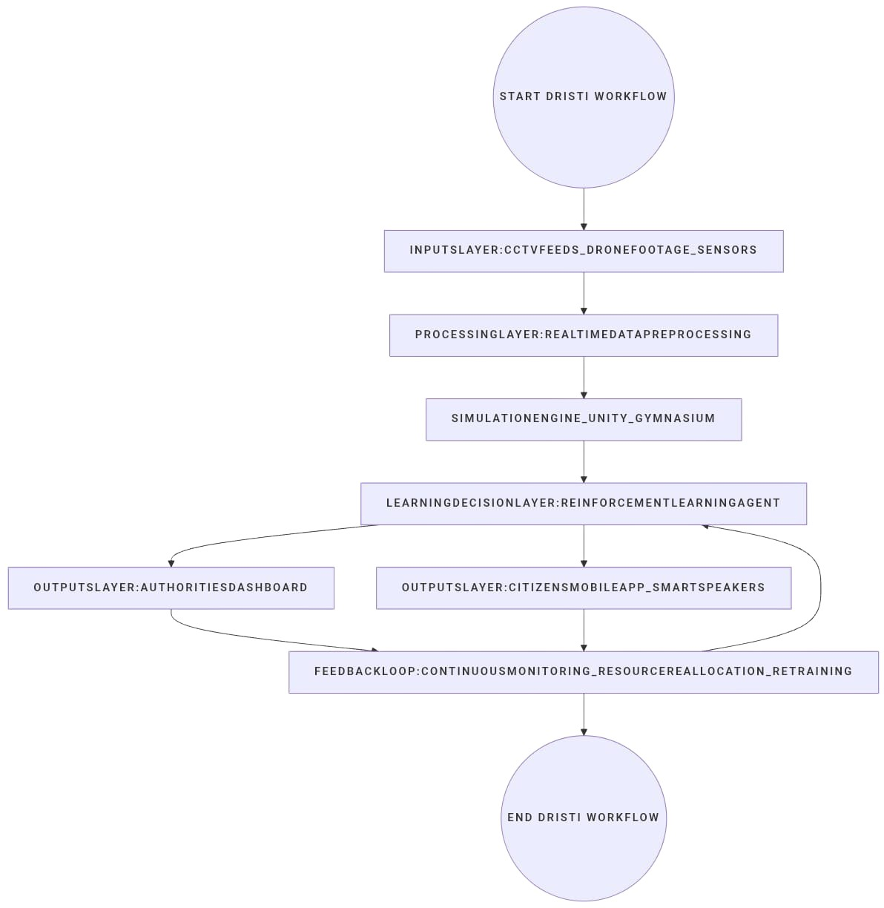
THE ENGINE ROOM
Technical Architecture:
Core Modules & Technologies
Crowd & Hazard Detection
Vision: We leverage YOLOv8 / YOLO NAS for rapid and precise object detection. This is critical for identifying individuals, vehicles, and potential hazards from diverse feeds like CCTV and drone footage. OpenCV is integral for robust image and video processing.
Fire Detection: Integration with physical sensors such as MQ2 (for smoke/gas detection) and specialized flame sensors enables instant fire identification. This is augmented by a custom-trained thermal ML classifier for enhanced accuracy.
Disaster Simulation Engine
Simulations: The core learning environment is built on Unity or Gymnasium. These platforms provide a realistic physics engine for modeling complex behaviors, including fire spread, panic dynamics, and optimal ambulance routing in congested environments.
Reward Function: The Reinforcement Learning agent is trained using a sophisticated reward function designed to incentivize positive outcomes. This function includes:
Positive Rewards: Rapid and safe evacuation, minimizing panic levels, and maximizing lives saved.
Negative Penalties: Congestion, increased panic, and casualties. This rigorous framework ensures the agent prioritizes human safety and efficient resource utilization above all else.

Slide 6
DRISTI IN ACTION
Prototype Demo: Visualizing Intelligent Response
Live Dashboard
Citizen App Interface
Simulation Environment
The command center for authorities: an interactive map with dynamic crowd density heatmaps, identified hazard locations (with live video feeds), and real-time positions of emergency assets (ambulances, fire trucks, drones). Operators can toggle data layers for a complete situational overview.
Designed for panic situations: displays the safest evacuation route from the user's current location, clear alerts in local languages, and pinpoint locations of nearest medical camps or emergency services. The UI is minimalist for high usability under stress.
The system's brain: a simulated city grid undergoing a disaster (e.g., fire). Shows virtual people reacting, with the RL agent's decisions in action—e.g., a green line for a rerouted evacuation path and a drone icon moving to a search area—demonstrating training and validation.

Slide 7
REAL-WORLD APPLICATION
Impact & Use Cases: Transforming Public Safety
Who Benefits and How?
Key Use Cases
Authorities & First Responders: Empowered with proactive decision-making. DRISTI optimizes resource allocation, ensuring the right assets are deployed at the right time. This dramatically reduces response times and enhances the management of complex, multi-faceted incidents.
Large Public Gatherings: Ideal for events like Simhastha, concerts, sports matches, and religious festivals, which are characterized by high population density and rapid escalation potential.
Urban Emergencies: Applicable for managing fires in crowded market areas, traffic incidents on major highways, or controlling crowd flow during city-wide festivals.
Citizens: The ultimate beneficiaries. They receive clear, real-time, and localized guidance, enabling safer choices during emergencies. This reduces panic, prevents stampedes, and ultimately saves more lives.
Natural Disasters: DRISTI's simulation capabilities can be adapted to provide dynamic evacuation routes during natural calamities such as floods or earthquakes, accounting for real-time changing conditions.

Slide 8
THE ROAD AHEAD
Future Scope: Evolving DRISTI's Capabilities
Planned Improvements
Scalability
Multi-Agent RL: Development of collaborative RL agents to tackle complex, large-scale problems. For example, one agent managing crowd flow while another coordinates medical teams.
Expanding the simulation engine to model various disaster types and terrains, from dense urban landscapes to remote rural areas.
Advanced Sensor Integration: Incorporating diverse data sources like drone footage, satellite imagery, and real-time social media feeds for a more holistic and accurate situational picture.
Designing a modular system for seamless integration with existing national disaster management frameworks, facilitating country-wide deployment.
Predictive Maintenance: Leveraging historical data and simulations to predict and mitigate potential hazards before they escalate, such as identifying high-density areas before congestion becomes critical.
CONCLUSION: Why DRISTI Stands Out?
DRISTI is not merely an alert system; it's a dynamic, intelligent ecosystem using reinforcement learning for autonomous, optimal decision-making in real-time. By merging real-time data with a powerful simulation engine, it transforms chaos into manageable, data-driven responses. Our prototype offers a unique, proactive solution that saves lives by ensuring resources are precisely where needed and citizens receive accurate information instantly. We believe this represents the next generation of disaster preparedness.

